Slide 1
Custom Information Requirement for RMA unit
Step 1: The sender to send the information about the shipment to the factory in advance for checking
(Information following step 2)
Step 2: During the preparation of the shipment, the following information must be fully provided for custom inspection purposes
1. Products must be originated from Vietnam - “Made in Vietnam”. Incase of “Made in Vietnam” don’t show on housing label it must be indicated on label gift box.
2. Products must be in the original state, with no hardware modification, warranty stamp intact and no impacted by cosmetic (Must provide confirmation letter or email to confirm)
3. Confirmation quantity for import type( A31- domestic consumption or destroyed/G13- re-exported to the customer or re-exported to a third country or to a non-tariff area).
4. Provide pictures of products, product labels and it must include contains model name/country of origin
If in the case the number of sample returned is less than 3 units, the sender must provide photos of all samples
If in the case of more than 3 units sent back, the sender must provide the picture of the 3 units of the shipment, but a letter is required to confirm that the remaining quantity of the shipment is the same.
5. Provide packing list include total qty, qty per carton (pcs / CTN), per pallet (CTNs / PLT), net-weight, gross-weight… etc.,
6. The AWB must have the correct factory address
Send to: BOWIE/TSOI / BO YEUNG Tel: (852) 3974 9190 / 3974 9066
Factory address: Bang Tai international logistics Co., LTD
(CNSBG Department) WareHouse A, DD118, LOT 1120 RP Yau Cha
Po Village,TaiShuHa Road West,Yuen Long,N.T.,HongKong.

Slide 2
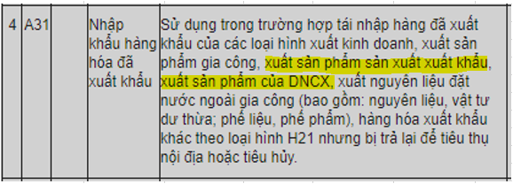
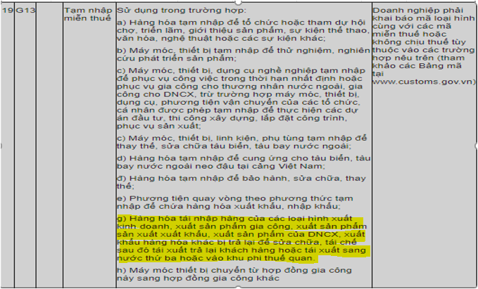
Import types followed Decree No. 1357/QĐ-TCHQ
1. Type A31- Import returned goods (Included Export Processing Enterprises-EPEs). This is indicated for all products which re-import to repair/recycling…then destroyed or domestic consumption.
2. Type G13 – Import returned good. Following Type G13-g: This is indicated for all products which re-import to repair/recycling…then re-exported to the customer/re-exported to a third country or to a non-tariff area.

Slide 3
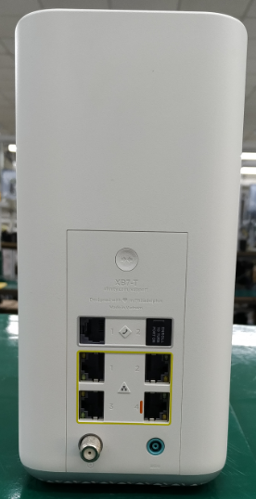
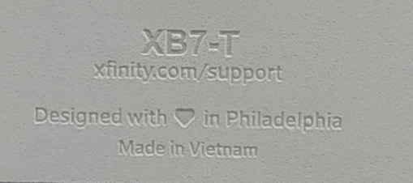
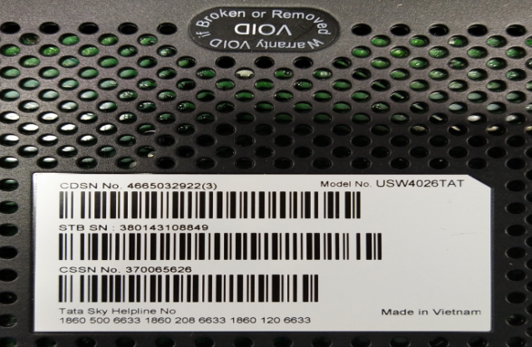
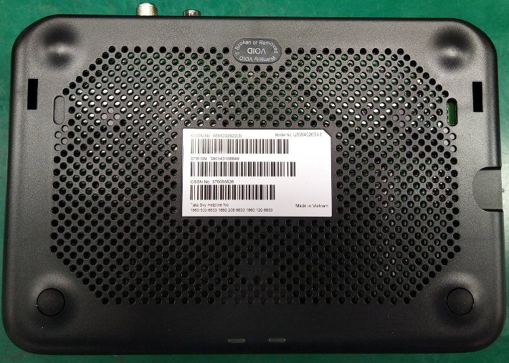
Example of the product
Warranty stamp intact
Made in Vietnam

Slide 4
Additional Requirement from BangTai Warehouse
Carton Label
Must include: a) H/H PN or Customer PN
b) Qty
c) COO e.g. Made in Vietnam
Volume over 0.2CBM/ over 5 cartons/ Over 10kgs/carton / Total weight over 50kgs→ Need to palletized
(if using wood pallet, need to have “IPPC” mark)
3. The label information on outer carton need to display clearly and match the packing information.
4. Need shipping company to discharge the cargo and separate the goods by ASN.
(Will have additional fee if need warehouse to discharge the cargo→ Need to inform in advance)

